Slide 1
Chapter 13

Slide 2
Clustering– Unsupervised learning
Why is cluster detection useful?
Excess of patterns many of which not be meaningful. eg too many competing radio signals add up to noise in reception.
Local trends. Eg price elasticity may be opposite in sign for different customer segments
Essence: intra-group similar, and inter-group different
There is no target variable.
Clustering can be a preliminary step for directed mining

Slide 3
Clustering
Model set is not pre-classified, ie target variable is not used
You’ve to determine whether the resulting clusters are of interest to business
After clusters are formed, next they may:
become objects of study
become a dimension in data warehousing
be inputs to other models
be monitored over time to see how customers migrate from one cluster to other

Slide 4
Clustering (cntd.)
Produce data mining models that can be used on other data sets to produce scores.
Scores are cluster assignments, which may be a single cluster label (“hard” assignment), or estimates of probability of membership in each cluster (“soft” assignment).
Another way to characterize cluster is to look at a typical member and ask which features of this member are most different from the overall population.
Undirected in technical sense, but directed in business sense. Eg customer segmentation is a popular application of clustering.

Slide 5
Customer segmentation and clustering
Segmenting customers into clusters that are expected to behave similarly is useful
for targeting cross-sell offers
for focusing retention efforts
for customizing messaging
for selling ads to advertisers
for customizing products or services
Segments are formed typically based on geography, demography, product usage, length of relationship, attitudes expressed in surveys

Slide 6
Example: Credit-card clusters
A credit-card company’s profitable clusters
High-balance revolvers
Profitable segment because pay interest on high-balance
High-volume transactors
Profitable make many transactions and card issuer receives a percentage of transactions
Convenience users
Occasional large purchases that they pay over time

Slide 7
Example: Clustering vs Decision tree
Management wanted to use k-means clustering to better focus at retention problem
Customers in clusters from k-means had different retention characteristics
However, by using retention as a target variable and keeping leaf size quite large, only a few leaves were created.
Advantage: Decision tree leaves also come with business rules

Slide 8
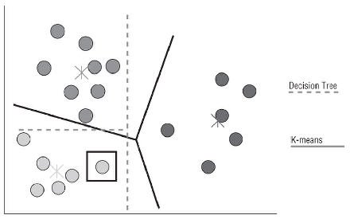
Clustering vs Decision tree (cntd.)
Typically a good consensus between the two
One important difference:
Boundaries of the decision tree leaves are always parallel to an axis, because each split is in the form if X>10 then go left otherwise go right.
In contrast, the boundaries of k-means clusters can be at any angle.

Slide 9
Clustering (cntd.)
What variables should be used to define clusters?
Count of events can be defined based on same time unit for comparison. Eg complaint rate, subscription rate, contact rate
It is a good idea to standardize variables, ie use z-values for comparability
Segmenting first based on a key variable such as tenure, and then run clustering for the 2 segments, which maybe tenureMoreThanAnYear, tenureLessThanAnYear

Slide 10
Example: Clustering discovered a market segment
Bank of Americas home equity loans
Before clustering, segments that were considered
Parents of college-age children. Were promoted the idea of using loan towards tuition
People with high but variable incomes
After clustering
Found a cluster with the following difference than population: unusually high density of loans, and cluster members had much higher percentage of customers had both personal and business accounts for same tax-id suggesting sole-proprietorship
Using loans to fund business.
Campaign was changed for such customers and was better received (7%)

Slide 11
Example: US army sizes for women
Used 100 measurements for 3000 women
Clusters much different from the civilian alternatives
Recommendations not implemented because of increased cost for “mil spec”.

Slide 12
K-means clustering
One of the most popular clustering technique
“k” refers to the number of clusters
Good cluster centers should be in the densest parts of the data cloud
2 steps: Assignment and Update
Initial cluster seeds are chosen randomly
Assignment: Members are assigned to the cluster with closest seed.
Update: After assigning all members, cluster centroid is calculated.
Centroid is the average position of cluster members in each dimension.

Slide 13
Voronoi Diagrams
Voronoi diagram, a diagram whose lines mark the points that are equidistant from the two nearest cluster centers.
Result is that each region on a Voronoi diagram consists of all points closest to one of the cluster centers.
A good way to visualize the k-means clustering algorithms
Can facilitate nearest neighbor queries such as the location of the closest metro statin, cell phone tower, or Starbucks.

Slide 14
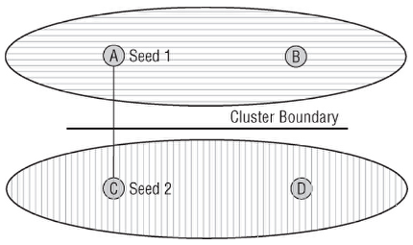
Problem with k-means clustering
Initial seeds may lead to sub-optimal clusters
Choose different seeds and check the stability of clusters. If no stable clusters are found then:
No good clusters are there
Value of “k” needs to be changed
Or it didn’t find it yet

Slide 15
How do you use “k”?
It may be determined by the number of segments the business can support
Typically a business needs may suggest a range of acceptable values
Try all k-values and evaluate based on:
Something that makes sense
Technical criteria such as the
ratio of average intra-cluster distance to average inter-cluster distance
the cluster silhouette
Even if technical criterion is used, subjective evaluation is still needed.

Slide 16
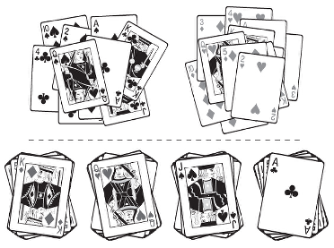
k=2 vs k=4 (deck of cards)
There is no one correct clustering, so business acumen is needed to make a call.

Slide 17
Using k-means to detect outliers
“outside” should be defined as beyond some threshold distance from the cluster
Single linkage: the distance to the nearest cluster member.
Takes into account that the “usual” cluster may have a highly irregular shape instead of spherical shape
Complete linkage: the distance to the farthest cluster member.
Centroid linkage: the distance to the centroid of the cluster.
Examples for “outside the usual clusters”
in medicine to detect the presence of abnormal cells in tissue samples
in telecommunication to detect calling patterns indicative of fraud.

Slide 18
Semi-directed clustering
Good option when there is more than one target
With a single target decision tree is more effective.
Case study: Boston Globe
How to decide editorial zone boundaries?
How to interpret clusters
What is common among intra-cluster members?
What is different among clusters?

Slide 19
Which variables are most important for defining which clusters?
Take the difference between average value within a particular cluster and average of the same variable in the overall population.
Divide the difference with the standard deviation of the variable in the overall population to represent it as a z-score.
Order variables by magnitudes of the z-scores. This is also the order of importance of variables in defining a given cluster.

Slide 20
Cluster characteristics
Cluster diameter: It is the maximum distance between any two records in the same cluster.
Cluster variance: It is the sum of the squared distance from the centroid of cluster members.
Silhouette: It is a measure of cluster dispersion or goodness
First calculate the average distance (dissimilarity) between a member and other members of the same cluster.
Next, calculate the average distance between a member and members of the nearest cluster.
Difference between the above divided by the distance between a member and members of nearest cluster is silhouette score.
Silhouette score can go from negative one to one.
Silhouette score of all members of a cluster are averaged to calculate cluster silhouette.

Slide 21
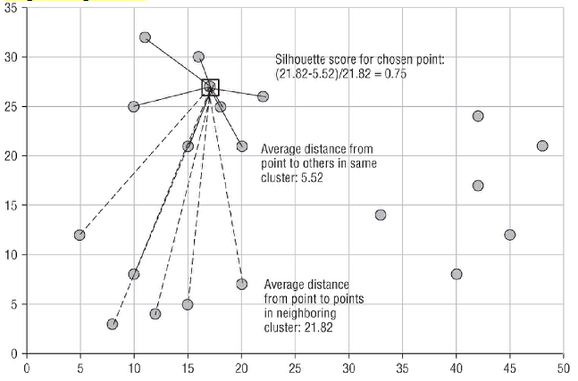
Silhouette Score

Slide 22
Silhouette score (cntd.)
Silhouette scores can be used to choose an appropriate value of k.
It can also be used to compare clusters produced by different random seeds.
Strong clusters can be removed for further analysis.

Slide 23
Clustering (cntd.)
Rule that a record should be assigned to the closest cluster allows the cluster to grow literally without bound.
Imposing a maximum cluster-diameter is prudent.

Slide 24
A version of Divisive clustering
First run k-means clustering algorithm using the smallest “k”
Using fitness measure (such as silhouette measure, variance, average distance from cluster center) determine the worst cluster.
Using data from the weaker clusters, repeat the clustering process till the upper bound on “k” is reached

Slide 25
Results from Boston Globe case study
Used k-means clustering process as described in previous slide
Restructuring of zones based on demographical measures.
How would it help the newspaper?
Better customization of editorial focus in special editions lead to better circulation.
Better demographic clustering lead to better negotiations with advertisers.

Slide 26
Variations of k-means
Centroids may not be any actual data-point
K-medians:
looks for the set of centroids that minimizes the sum of the distances from cluster members to cluster centroids.
The new center is the median along each dimension, rather than average.
Median, minimizes the sum of the distance from itself to all members of the set. It is less sensitive to outliers.
Application: picking facilities to minimize distances
K-medoids
The next center is the best representative object for each cluster.
Advantage: Because it is actual object, they have actual values for fields not used for clustering.
Soft side of K-means
Instead of assigning a record to one cluster, it is assigned fuzzy membership to all clusters.

Slide 27
Scaling and weighting variables
Scaling variables: calculate z-scores, ie subtract mean and divide it by the standard deviation.
Weighting: provides a relative adjustment for a variable, because some variables are more important than others.
After scaling to get rid of bias due to units, use weights to introduce bias based on knowledge of the business context.

Slide 28
3 types of clustering
k-means clustering: start with a fixed number of clusters, and make clusters based on a criterion—minimum distance from the centroid
Divisive clustering: start with one cluster and keep breaking till some stopping rule gets triggered.
Hierarchical clustering: start with every record in its own cluster.

Slide 29
Ward method
Ward method implements hierarchical clustering
When we summarize data, we increase interpretability but we loose information.
It minimizes the loss of information that occurs when the group is described by the average values of group members’ variables.
Only continuous variables can be used.
Loss of information is based on distances or on squared distances. In latter case, use “error sum of squares” or ESS.
Records with the smallest ESS are joined to form the first cluster.
Dendogram helps to select the number of clusters to ultimately work with.
Unsuitable for large databases because it is computationally intensive.

Slide 30
Hierarchical agglomerative clustering
Starts with every record in its own cluster.
Clusters gradually merge, forming larger and larger groupings.
Merging happens till all records in one cluster.

Slide 31
Hierarchical clustering
It is computationally expensive.
It can be difficult to visualize the clusters.
It is quite sensitive to outliers.

Slide 32
A way of identifying optimal number of clusters in hierarchical clustering
Biggest information gain going from one cluster level to the other.
Business constraints and subjective judgment is still needed.

Slide 33
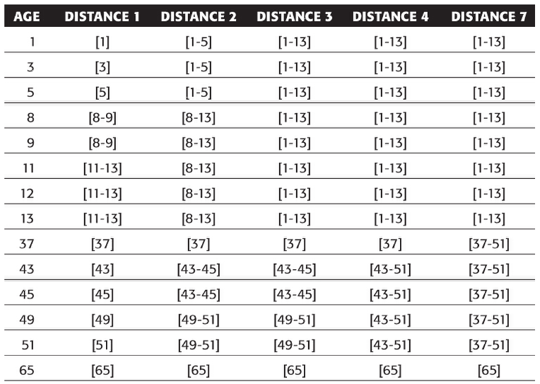
Eg of Agglomerative clustering

